Slide 1
William Stallings
Data and Computer Communications
7th Edition
Chapter 10
Circuit Switching and Packet Switching

Slide 2
Switching Networks
Long distance transmission is typically done over a network of switched nodes
Nodes not concerned with content of data
End devices are stations
  Computer, terminal, phone, etc.
A collection of nodes and connections is a communications network
Data routed by being switched from node to node

Slide 3
Nodes
Nodes may connect to other nodes only, or to stations and other nodes
Node to node links usually multiplexed
Network is usually partially connected
  Some redundant connections are desirable for reliability
Two different switching technologies
  Circuit switching
  Packet switching

Slide 4
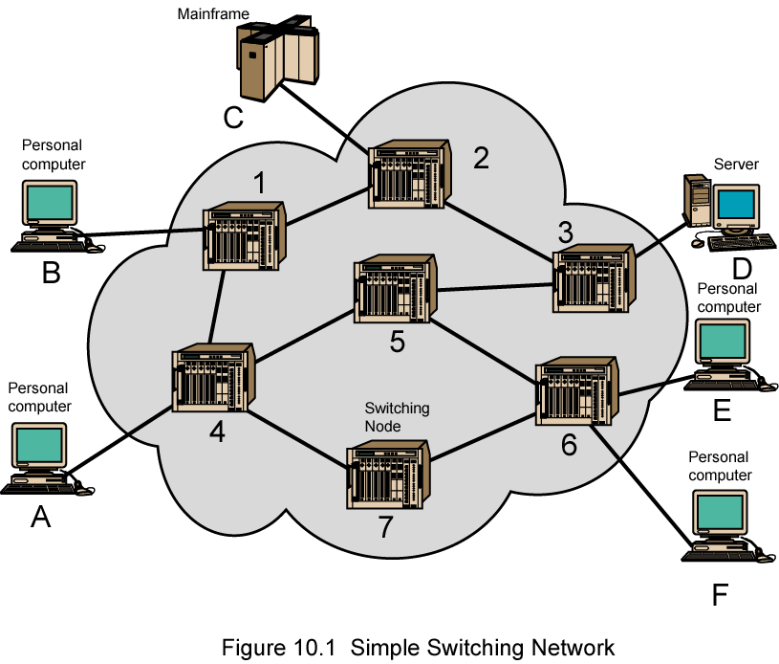
Simple Switched Network

Slide 5
Circuit Switching
Dedicated communication path between two stations
Three phases
  Establish
  Transfer
  Disconnect
Must have switching capacity and channel capacity to establish connection
Must have intelligence to work out routing

Slide 6
Circuit Switching - Applications
Inefficient
  Channel capacity dedicated for duration of connection
  If no data, capacity wasted
Set up (connection) takes time
Once connected, transfer is transparent
Developed for voice traffic (phone)

Slide 7
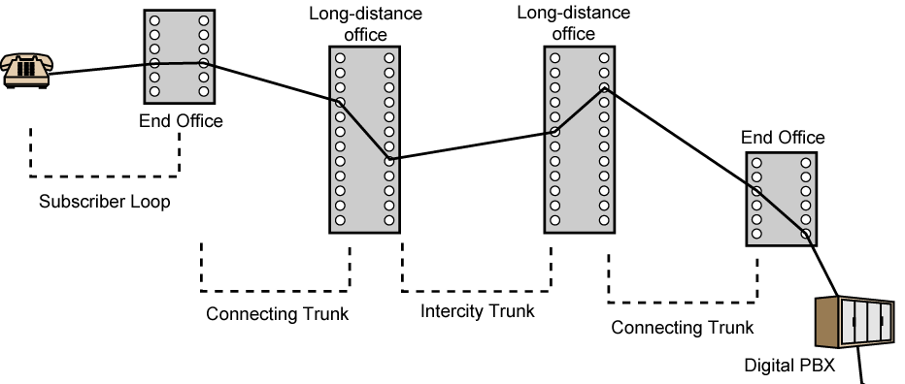
Public Circuit Switched Network

Slide 8
Telecomms Components
Subscriber
  Devices attached to network
Subscriber line
  Local Loop
  Subscriber loop
  Connection to network
  Few km up to few tens of km
Exchange
  Switching centers
  End office - supports subscribers
Trunks
  Branches between exchanges
  Multiplexed

Slide 9
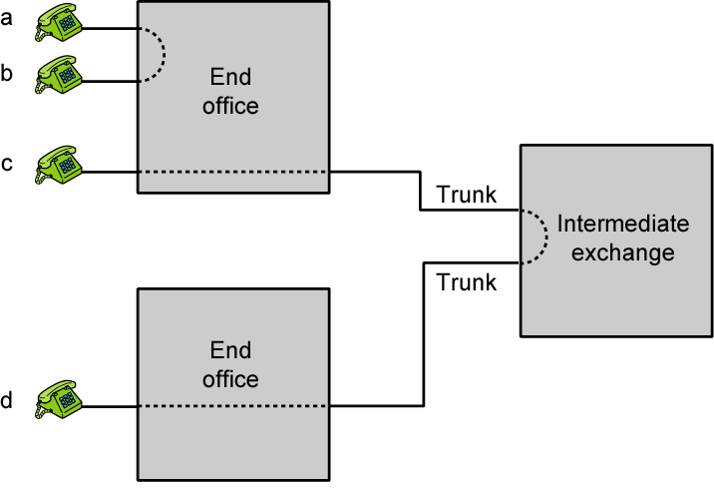
Circuit Establishment

Slide 10
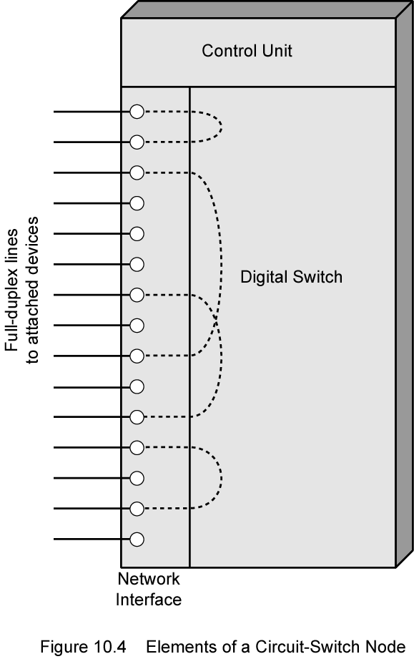
Circuit Switch Elements

Slide 11
Circuit Switching Concepts
Digital Switch
  Provide transparent signal path between devices
Network Interface
Control Unit
  Establish connections
    Generally on demand
    Handle and acknowledge requests
    Determine if destination is free
    construct path
  Maintain connection
  Disconnect

Slide 12
Blocking or Non-blocking
Blocking
  A network is unable to connect stations because all paths are in use
  A blocking network allows this
  Used on voice systems
    Short duration calls
Non-blocking
  Permits all stations to connect (in pairs) at once
  Used for some data connections

Slide 13
Space Division Switching
Developed for analog environment
Separate physical paths
Crossbar switch
  Number of crosspoints grows as square of number of stations
  Loss of crosspoint prevents connection
  Inefficient use of crosspoints
    All stations connected, only a few crosspoints in use
  Non-blocking

Slide 14
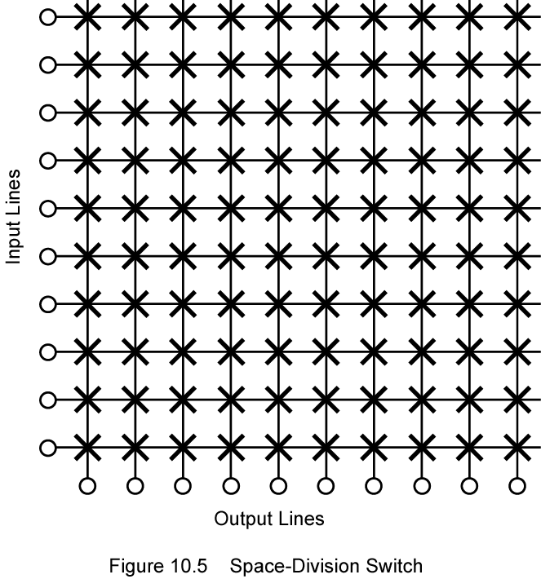
Space Division Switch

Slide 15
Multistage Switch
Reduced number of crosspoints
More than one path through network
  Increased reliability
More complex control
May be blocking

Slide 16
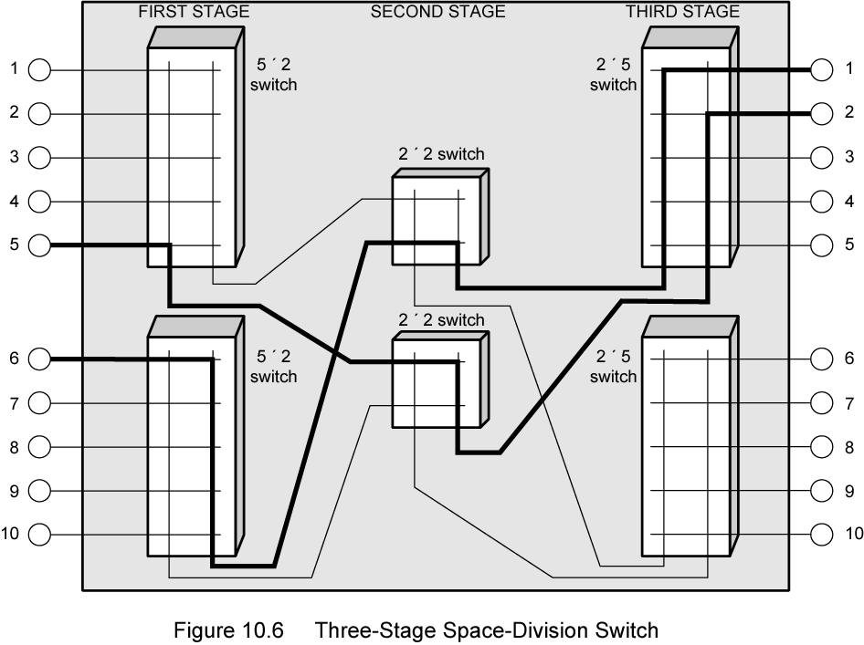
Three Stage Space Division Switch

Slide 17
Time Division Switching
Modern digital systems rely on intelligent control of space and time division elements
Use digital time division techniques to set up and maintain virtual circuits
Partition low speed bit stream into pieces that share higher speed stream

Slide 18
Control Signaling Functions
Audible communication with subscriber
Transmission of dialed number
Call can not be completed indication
Call ended indication
Signal to ring phone
Billing info
Equipment and trunk status info
Diagnostic info
Control of specialist equipment

Slide 19
Control Signal Sequence
Both phones on hook
Subscriber lifts receiver (off hook)
End office switch signaled
Switch responds with dial tone
Caller dials number
If target not busy, send ringer signal to target subscriber
Feedback to caller
  Ringing tone, engaged tone, unobtainable
Target accepts call by lifting receiver
Switch terminates ringing signal and ringing tone
Switch establishes connection
Connection release when Source subscriber hangs up

Slide 20
Switch to Switch Signaling
Subscribers connected to different switches
Originating switch seizes interswitch trunk
Send off hook signal on trunk, requesting digit register at target switch (for address)
Terminating switch sends off hook followed by on hook (wink) to show register ready
Originating switch sends address

Slide 21
Location of Signaling
Subscriber to network
  Depends on subscriber device and switch
Within network
  Management of subscriber calls and network
  ore complex

Slide 22
In Channel Signaling
Use same channel for signaling and call
  Requires no additional transmission facilities
Inband
  Uses same frequencies as voice signal
  Can go anywhere a voice signal can
  Impossible to set up a call on a faulty speech path
Out of band
  Voice signals do not use full 4kHz bandwidth
  Narrow signal band within 4kHz used for control
  Can be sent whether or not voice signals are present
  Need extra electronics
  Slower signal rate (narrow bandwidth)

Slide 23
Drawbacks of In Channel Signaling
Limited transfer rate
Delay between entering address (dialing) and connection
Overcome by use of common channel signaling

Slide 24
Common Channel Signaling
Control signals carried over paths independent of voice channel
One control signal channel can carry signals for a number of subscriber channels
Common control channel for these subscriber lines
Associated Mode
  Common channel closely tracks interswitch trunks
Disassociated Mode
  Additional nodes (signal transfer points)
  Effectively two separate networks

Slide 25
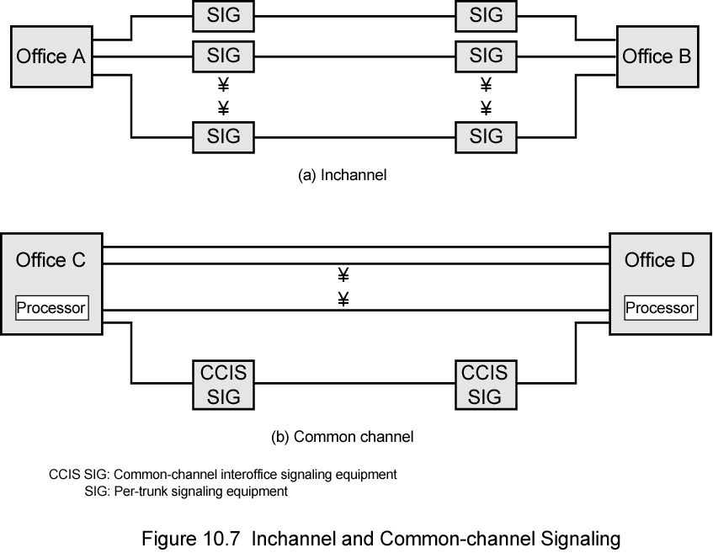
Common v. In Channel Signaling

Slide 26
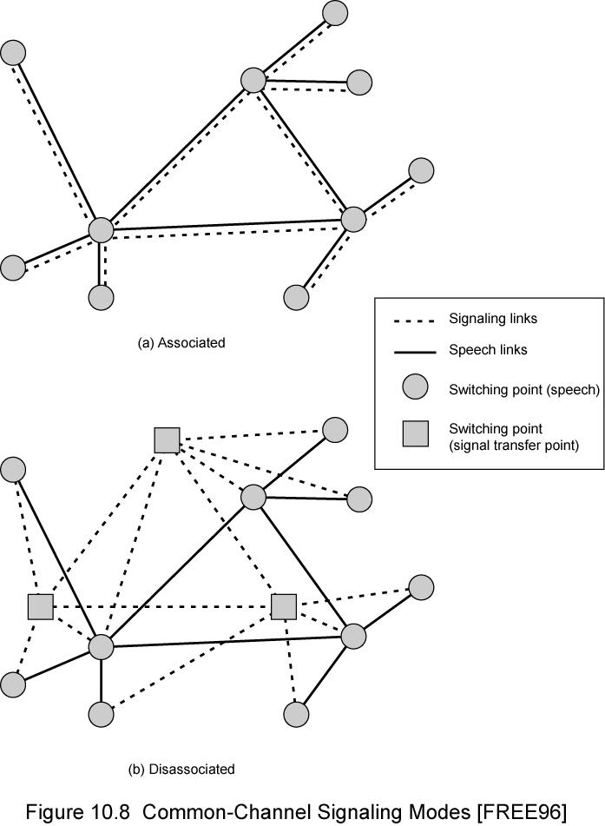
Common
Channel
Signaling
Modes

Slide 27
Signaling System Number 7
SS7
Common channel signaling scheme
ISDN
Optimized for 64k digital channel network
Call control, remote control, management and maintenance
Reliable means of transfer of info in sequence
Will operate over analog and below 64k
Point to point terrestrial and satellite links

Slide 28
SS7
Signaling Network Elements
Signaling point (SP)
  Any point in the network capable of handling SS7 control message
Signal transfer point (STP)
  A signaling point capable of routing control messages
Control plane
  Responsible for establishing and managing connections
Information plane
  Once a connection is set up, info is transferred in the information plane

Slide 29
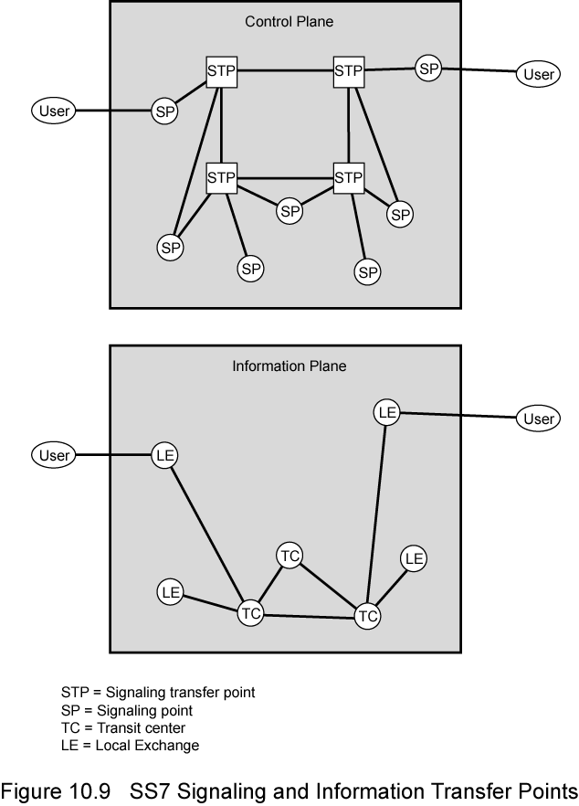
Transfer
Points

Slide 30
Signaling Network Structures
STP capacities
  Number of signaling links that can be handled
  Message transfer time
  Throughput capacity
Network performance
  Number of SPs
  Signaling delays
Availability and reliability
  Ability of network to provide services in the face of STP failures

Slide 31
Softswitch Architecture
General purpose computer running software to make it a smart phone switch
Lower costs
Greater functionality
  Packetizing of digitized voice data
  Allowing voice over IP
Most complex part of telephone network switch is software controlling call process
  Call routing
  Call processing logic
  Typically running on proprietary processor
Separate call processing from hardware function of switch
Physical switching done by media gateway
Call processing done by media gateway controller

Slide 32
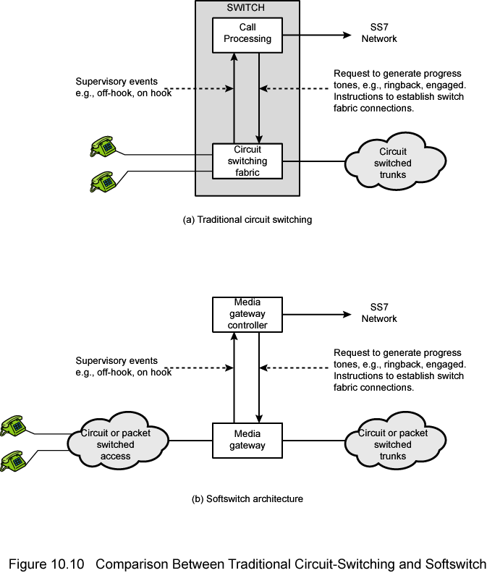
Traditional Circuit Switching

Slide 33
Softswitch

Slide 34
Packet Switching Principles
Circuit switching designed for voice
  Resources dedicated to a particular call
  Much of the time a data connection is idle
  Data rate is fixed
    Both ends must operate at the same rate

Slide 35
Basic Operation
Data transmitted in small packets
  Typically 1000 octets
  Longer messages split into series of packets
  Each packet contains a portion of user data plus some control info
Control info
  Routing (addressing) info
Packets are received, stored briefly (buffered) and past on to the next node
  Store and forward

Slide 36
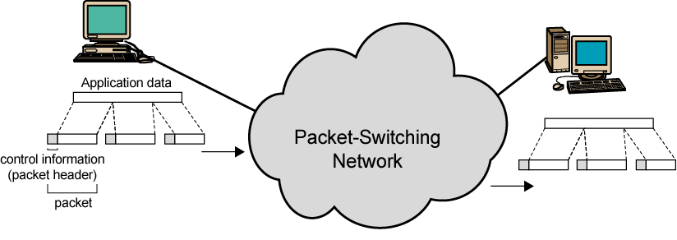
Use of Packets

Slide 37
Advantages
Line efficiency
  Single node to node link can be shared by many packets over time
  Packets queued and transmitted as fast as possible
Data rate conversion
  Each station connects to the local node at its own speed
  Nodes buffer data if required to equalize rates
Packets are accepted even when network is busy
  Delivery may slow down
Priorities can be used

Slide 38
Switching Technique
Station breaks long message into packets
Packets sent one at a time to the network
Packets handled in two ways
  Datagram
  Virtual circuit

Slide 39
Datagram
Each packet treated independently
Packets can take any practical route
Packets may arrive out of order
Packets may go missing
Up to receiver to re-order packets and recover from missing packets

Slide 40
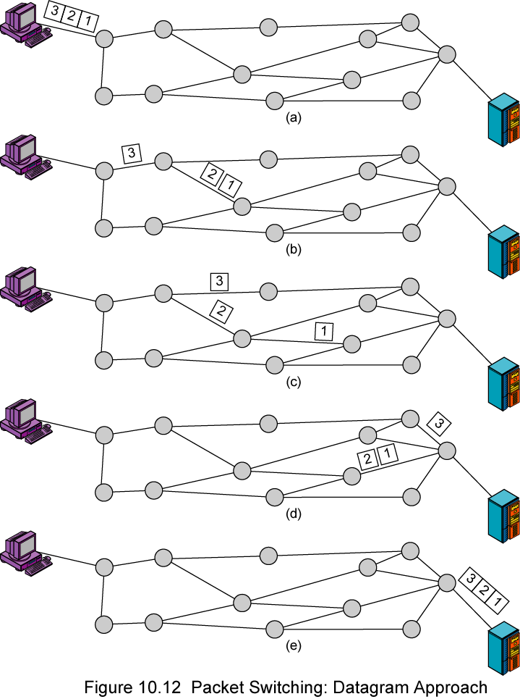
Datagram
Diagram

Slide 41
Virtual Circuit
Preplanned route established before any packets sent
Call request and call accept packets establish connection (handshake)
Each packet contains a virtual circuit identifier instead of destination address
No routing decisions required for each packet
Clear request to drop circuit
Not a dedicated path

Slide 42
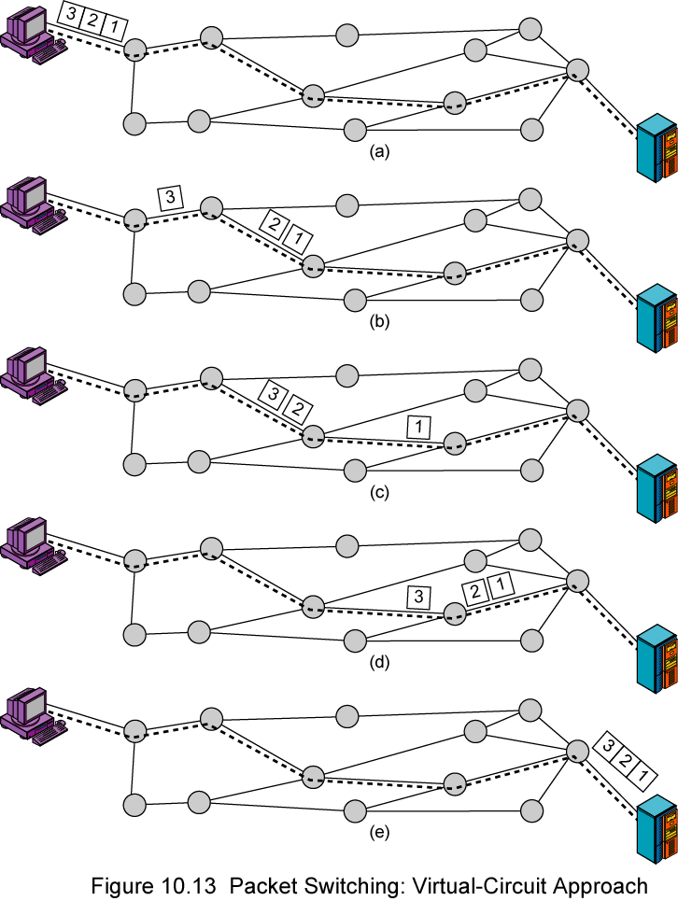
Virtual
Circuit
Diagram

Slide 43
Virtual Circuits v Datagram
Virtual circuits
  Network can provide sequencing and error control
  Packets are forwarded more quickly
    No routing decisions to make
  Less reliable
    Loss of a node looses all circuits through that node
Datagram
  No call setup phase
    Better if few packets
  More flexible
    Routing can be used to avoid congested parts of the network

Slide 44
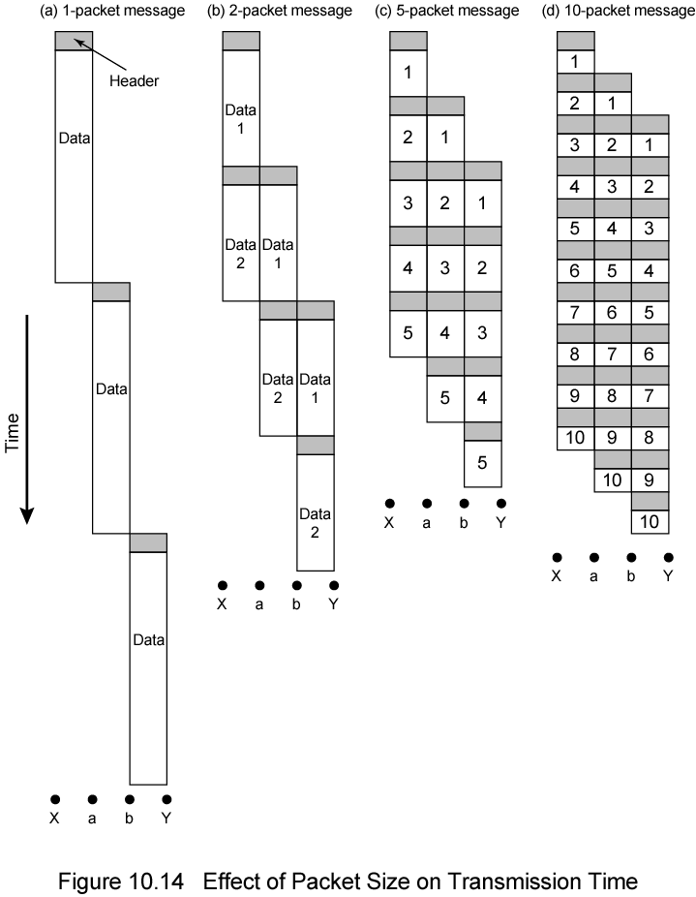
Packet Size

Slide 45
Circuit v Packet Switching
Performance
  Propagation delay
  Transmission time
  Node delay

Slide 46
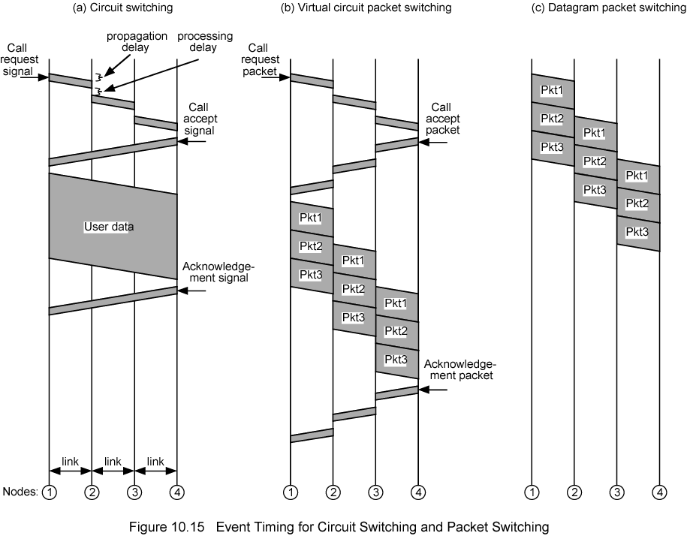
Event Timing

Slide 47
X.25
1976
Interface between host and packet switched network
Almost universal on packet switched networks and packet switching in ISDN
Defines three layers
  Physical
  Link
  Packet

Slide 48
X.25 - Physical
Interface between attached station and link to node
Data terminal equipment DTE (user equipment)
Data circuit terminating equipment DCE (node)
Uses physical layer specification X.21
Reliable transfer across physical link
Sequence of frames

Slide 49
X.25 - Link
Link Access Protocol Balanced (LAPB)
  Subset of HDLC
  see chapter 7

Slide 50
X.25 - Packet
External virtual circuits
Logical connections (virtual circuits) between subscribers

Slide 51
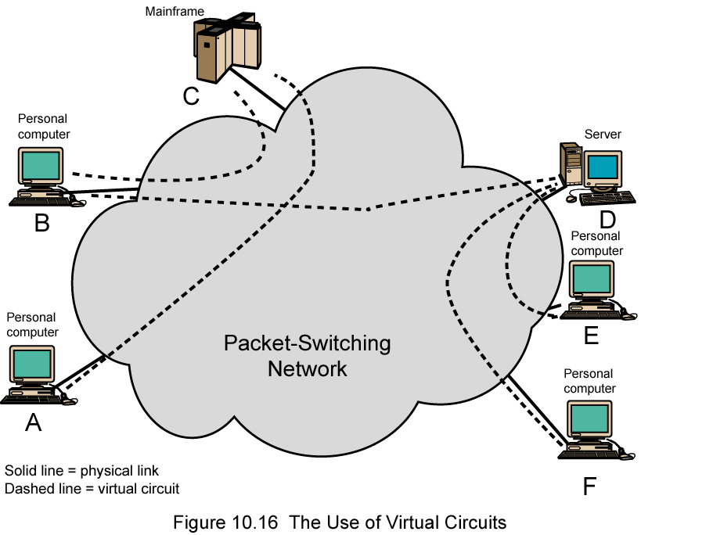
X.25 Use of Virtual Circuits

Slide 52
Virtual Circuit Service
Logical connection between two stations
  External virtual circuit
Specific preplanned route through network
  Internal virtual circuit
Typically one to one relationship between external and internal virtual circuits
Can employ X.25 with datagram style network
External virtual circuits require logical channel
  All data considered part of stream

Slide 53
X.25 Levels
User data passes to X.25 level 3
X.25 appends control information
  Header
  Identifies virtual circuit
  Provides sequence numbers for flow and error control
X.25 packet passed down to LAPB entity
LAPB appends further control information

Slide 54
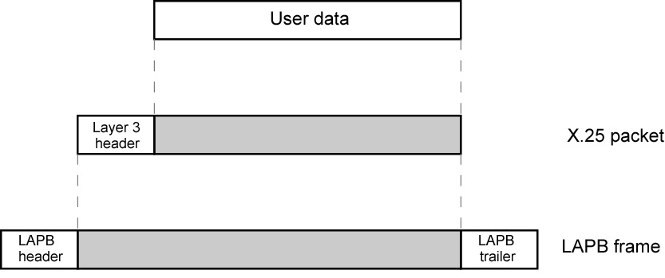
User Data and X.25 Protocol Control Information

Slide 55
Frame Relay
Designed to be more efficient than X.25
Developed before ATM
Larger installed base than ATM
ATM now of more interest on high speed networks

Slide 56
Frame Relay Background - X.25
Call control packets, in band signaling
Multiplexing of virtual circuits at layer 3
Layer 2 and 3 include flow and error control
Considerable overhead
Not appropriate for modern digital systems with high reliability

Slide 57
Frame Relay - Differences
Call control carried in separate logical connection
Multiplexing and switching at layer 2
  Eliminates one layer of processing
No hop by hop error or flow control
End to end flow and error control (if used) are done by higher layer
Single user data frame sent from source to destination and ACK (from higher layer) sent back

Slide 58
Advantages and Disadvantages
Lost link by link error and flow control
  Increased reliability makes this less of a problem
Streamlined communications process
  Lower delay
  Higher throughput
ITU-T recommend frame relay above 2Mbps

Slide 59
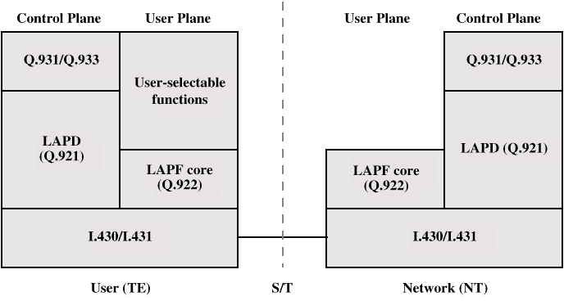
Protocol Architecture

Slide 60
Control Plane
Between subscriber and network
Separate logical channel used
  Similar to common channel signaling for circuit switching services
Data link layer
  LAPD (Q.921)
  Reliable data link control
  Error and flow control
  Between user (TE) and network (NT)
  Used for exchange of Q.933 control signal messages

Slide 61
User Plane
End to end functionality
Transfer of info between ends
LAPF (Link Access Procedure for Frame Mode Bearer Services) Q.922
  Frame delimiting, alignment and transparency
  Frame mux and demux using addressing field
  Ensure frame is integral number of octets (zero bit insertion/extraction)
  Ensure frame is neither too long nor short
  Detection of transmission errors
  Congestion control functions

Slide 62
User Data Transfer
One frame type
  User data
  No control frame
No inband signaling
No sequence numbers
  No flow nor error control

Slide 63
Required Reading
Stallings Chapter 10
ITU-T web site
Telephone company web sites (not much technical info - mostly marketing)
X.25 info from ITU-T web site
Frame Relay forum

